Slide 1
Socio-Technical Systems Technology Human Capabilities
William J. Frey
College of Business Administration
University of Puerto Rico at Mayaguez

Slide 2
Definition: Socio-Technical System
Socio-Technical System
“an intellectual tool to help us recognize patterns in the way technology is used and produced” (Huff, “What is a Socio-Technical System?” from Computing Cases)
Socio-Technical systems provide a tool to uncover the different environments in which business activity takes place and to articulate how these constrain and enable different business practices.

Slide 3
1. STS as an environment
Socio-Technical systems provide a tool to uncover the different environments in which business activity takes place and to articulate how these constrain and enable different business practices.
Instrumenting action
enabling us to do new things
magnifying our ability to do old things
Constraining or determining action
we delegate actions and responsibility to technical artefacts
difficulty controlling complex systems

Slide 4
Complexity constrains as well as enables
Tightly coupled systems
difficult to contain a failure by isolation; failures tend to cascade throughout the system
a tightly coupled work-study relation breaks down when university changes a Monday to a Tuesday
Non-linear causality
actions “ripple” throughout the system producing changes/effects that are difficult to predict
no exams in the last week of classes prevents teachers and students from leaving early (=intended effects)
but it also leads to “stacking up” exams in the penultimate week

Slide 5
2. STS as System
STSs are Systems
A whole of interrelated parts that are related to one another and interact with one another
Requires systematic thinking:
actions feedback on the agent
the distinction between the agent (actor) and the objects targeted by agents (technical artifacts) begins to break down as artifacts
the environment or surroundings of action also feedback on the actor by constraining and enabling certain directions of action

Slide 6
Some examples
Prohibiting exams during the last week of the semester
Goal: Prevent teachers and students from ending the semester early
Actual Unintended results:
Exams “stack up” in penultimate week of the semester
Certain pedagogical approaches are constrained while others are enabled
Reflective and summative activities discouraged
Comprehensive, content based exams are imposed
Changing schedule to respond to holidays
Creating conflicts for students who have attempted to coordinate working and class schedules

Slide 7
3. STSs and their sub-environments
A STS can be divided into different parts or components that function as sub-environments
hardware, software, physical surroundings, stakeholders, procedures, laws, and information systems.
constrain and enable activities individually and collectively
Think about how the physical environment of the classroom embodies distinct pedagogical styles

Slide 8
How classrooms constrain and enable
 | Teacher Centered | Student Centered
Technologically enhanced | Room 236. Teacher has data display projector, computer, smart board, wireless keyboard, and mouse | Different computer stations distributed throughout classroom. No clear teacher stage and student receiving areas. Maybe a central discussion zone but information stations where students go to solve specific problems
Technologically deprived | Traditional classroom. Chairs arranged in rows to maximize control and discipline. Clear separation of teacher and student zones | Chairs and tables arranged in circle to promote discussion. Distinction between teacher and student zones breaks down.

Slide 9
4. STS embody values
moral values (justice, responsibility, respect, trust, and integrity)
non-moral values (efficiency, satisfaction, productivity, effectiveness, and profitability).
values can be located in one or more of the system components.
Often these values conflict with one another causing the system to change.
Example of conflict from university
Increasing tuition to cover cost increases creates distributive justice problems for students from poorer families

Slide 10
From Ethics of Teamwork, you learned…
that values can be designed into a STS through…
Discovery
discover’ the values that are relevant to, inspire, or inform a given design project
Translation
embodying or expressing…values in system design. Translation is further divided into operationalization, which involves defining or articulating values in concrete terms, and implementation which involves specifying corresponding design features
Verification
designers assess to what extent they have implemented target values in a given system…. [M]ay include internal testing among the design team, user testing in controlled environments, formal and informal interviews and surveys, the use of prototypes, traditional quality assurance measures such as automated and regression-oriented testing, and more
Flanagan, Howe, and Nissenbaum, “Embodying Values in Technology” in Information Technology and Moral Philosophy, van den Hoven and Weckert.

Slide 11
5. STSs change, tracing out a trajectory
STSs change and this change traces out a path or trajectory.
The normative challenge of STS analysis is to find the trajectory of STS change and work to make it as value positive and value realizing as possible.
Value positive trajectory?
Resolve value conflicts within system
Resolve value conflicts between different STSs
Value negative trajectory?

Slide 12
Techno-Socio Sensitivity
Respon-sibility Skill | Description | Module | Activities
Techno-socio sensitivity Socio-Technical Systems in Professional Decision Making (m14025 from Connexions) Responsible Choice for Appropriate Technology (m43922) | “critical awareness of the way technology affects society and the way social forces in turn affect the evolution of technology” CE Harris, (2008), “The good engineer: Giving virtue its due in engineering ethics,” Science and Engineering Ethics, 14(2): 153-164. | Socio-technical Systems 1. Different environments constrain and enable activity. 2.System of distinguishable but interrelated and interacting parts. 3. Embody / express moral and non-moral values. 4. Normative objective = tracing out a value positive path or trajectory of change. | Identifying sub-environments How each constrains activity How each enables or instruments activity Value vulnerabilities and conflicts Plot out system trajectories or paths of change

Slide 13
Technology, technical artifacts, social objects, natural objects

Slide 14
Distinctions
Artifacts: objects that are not found in nature but are made, designed, and created by humans
Social Artifacts: “play a role in ruling the behavior of humans, their natural cooperation and the relationships between humans and social institutions” Vermaas 11
laws, government, state, marriage, driving license, traffic laws, currency (money), organizations (corporations), contracts (including social contracts)
Artistic artifacts: works of art created for enjoyment and beauty
Technical artifacts: “material objects that have been deliberately produced by humans in order to fulfill some kind of practical function.” Vermaas, 5
technical function
physical composition
instructions for use (use or user guide)
Technology: the knowledge and skill that goes into the making of technical artifacts
Applied science
Craft and skill (handed down from generation to generation)
Engineering?

Slide 15
Hypothesis 1
Society determines technology
SCOT argues that technologies pass through three stages: interpretive flexibility, closing of interpretive flexibility, and the emergence of the technical “black box.”
From Penny Farthing bicycle to modern design (based on Lawson bicycle)
Typewriter and the QWERTY keyboard
Pinch and Bijker (Social Construction of Technology)

Slide 16
Hypothesis 2
Technology determines society
Winner and Perrow
Complexity (manifest and latent)
tightly coupled systems—difficult to control because it is impossible to isolate failures
non-linear causality—effects of acts ripple throughout system; non-linearity makes it difficult to predict the consequences of actions
Reverse Adaptation
Because complex technologies redefine needs (and values), we are forced to adapt ourselves (and our needs) to them.
Technological Imperative
Technologies transform and redefine human needs. Machine needs become imperative and trump human needs.

Slide 17
Neutrality Thesis
“from a moral point of view a technical artifact is a neutral instrument that can only be put to good or bad use…used for morally good or bad ends, when it falls into the hands of human beings.” (Vermaas 16)
Guns don’t kill people; people kill people.
At stake—Who is responsible for harms produced by the use or abuse of technology: the user or the designer?

Slide 18
Value-Laden Thesis
Values can be designed into technical artifacts
Howe, Flanagan, Nissenbaum
Value Discovery, Value Translation (operationalization and implementation) and Value Verification
Value Sensitive Design
Oosterlaken: Zooming in and Zooming out
“Zooming in…allows us to see the specific features or design details of technical artifacts; zooming out…allows us to see how exactly technical artifacts are embedded in broader socio-technical networks and practices.”
Flanagan, Howe, and Nissenbaum, “Embodying Values in Technology” in Information Technology and Moral Philosophy, van den Hoven and Weckert.
(See Taking a Capability Approach to Technology and Its Design: A Philosophical Exploration, Introduction, 14. Simon Stevin Series in the Ethics of Technology). (See Taking a Critical Approach to Technology and Its Design 13 (table) and 14.)

Slide 19
Again, designers can design value into a technology
Discovery
discover’ the values that are relevant to, inspire, or inform a given design project
Translation
embodying or expressing…values in system design. Translation is further divided into operationalization, which involves defining or articulating values in concrete terms, and implementation which involves specifying corresponding design features
Verification
designers assess to what extent they have implemented target values in a given system…. [M]ay include internal testing among the design team, user testing in controlled environments, formal and informal interviews and surveys, the use of prototypes, traditional quality assurance measures such as automated and regression-oriented testing, and more
Flanagan, Howe, and Nissenbaum, “Embodying Values in Technology” in Information Technology and Moral Philosophy, van den Hoven and Weckert.

Slide 20
The ontology of a technical artifact
Technical artifacts are relational, that is, they must be understood in relation to different contexts
Social context: technical artifact must be unpacked in terms of the use guide
But users can always develop procedures that circumvent (work around) the guide
STS: including laws (social artifacts), procedures, other technical artifacts, social context, information and information systems, economies

Slide 21
1. Summarize Your Case/Article
Summarize the article or summarize the literature you have consulted
The technology choice case
Your own case
Give the story
How did the project originate?
Was it successful?
Where did it take place?

Slide 22
2. Describe your Technology
Classify it as a social, aesthetic, or technical artifact
Like the clock in Frey’s office, it can be more than one
What does it do when it is fully functioning?
What is its technical function?
What is its physical composition? (Materials, ect.)
What are its “instructions for use” (User manual—Put the paper in the typewriter, center it, set the margin bell, etc.)

Slide 23
3. Do a Socio-Technical Analysis
Identify the key sub-environments
hardware, software, physical surroundings, stakeholder, procedures, laws, markets, information
Identify key value issues such as value conflicts
Moral Values: justice, responsibility, respect, trust, and integrity
Non-Moral Values: efficiency, effectiveness, profitability…
Are there any value conflicts, value vulnerabilities or potential harms?
Summarize this with a Socio Technical System Table

Slide 24
Like this one…
Technol-ogy | Software | Physical Surround-ngs | Stake-holders | Pro-cedures | Laws (univ regs) | Information systems
Classroom Computers Smart Board Data Display Projector Internet Connection | Microsoft Office (Social Networking Media) Google Documents Gantt Charts | Describe classroom and show how constrains interaction (Holding discussions with more than three) | Teacher, your group members, you, other teachers, other classmates Your boss (if you have a job outside of the univ) | Give one of your procedures for value realization Matricula (Does this procedure embody or frustrate justice?) | Rules on research misconduct Crazy Calendar (changing MWF to TTh; No exams in last week) | How your group assembles dispersed information Transferring information across STSs Informed Consent (providing info to others)

Slide 25
4. Discuss your technology and case using critieria of appropriate technology such as…
Ecologically sound
Low-cost
Low-maintenance
Labor intensive
Energy efficient
Simple, efficient, non-violent
Oosterlaken et al on Appropriate Technology
Conducive to decentralization
Compatible with laws of ecology
Makes use of modern knowledge
Gentle in the use of resources
Serves the human person
Production by the masses

Slide 26
5. Evaluate your technology using the Capability Approach
Does your technical artifact serve as a conversion factor that helps individuals turn capabilities into functionings?
What environmental/STS features stand in the way of the realization of the capabilities you have chosen?
Is your technical artifact a personal, social, or environmental conversion factor?

Slide 27
Capabilities Approach of Sen and Nussbaum
William Frey
ADEM

Slide 28
Capabilities Approach
“help answer the question, “What is this person able to do or be?”
“Substantial freedoms, causally interrelated opportunities to choose and act.”
“They are not just abilities residing inside a person but also freedoms or opportunities created by a combination of personal abilities and the political, social, and economic environment.”
Paradigm Shift
Replace view that these communities are deficient (have needs…) with view that communities are repositories of capabilities and resources that can be engaged.
Martha Nussbaum. Creating Capabilities: The Human Development Approach. Belknap Press of Harvard University Press, 2011, 20, 33-34.

Slide 29
Conversion Factors
Importance of realizing capabilities
Making real the human potentials of individuals is an essential part of happiness and wellbeing
In language of Capabilities Approach, this is turning capabilities into “functionings”
Means that realize capabilities are called conversion factors: private, social, environmental

Slide 30
More on conversion factors
Personal
Metabolism, physical condition, sex, reading skills, gender, race, caste
Social
Public policies, social norms, practices that unfairly discriminate, societal hierarchies, power relations related to class or gender, race, caste.
Environmental
Physical or built environment, climate, pollution, proneness to earthquakes, presence or absence of seas or oceans
Robeyns, Ingrid, "The Capability Approach", The Stanford Encyclopedia of Philosophy (Summer 2011 Edition), Edward N. Zalta (ed.), URL = <http://plato.stanford.edu/archives/sum2011/entries/capability-approach/>.

Slide 31
Create the background conditions where people are “empowered” to exercise their basic capabilities
Life Bodily Health Bodily Integrity | Sense, Imagination, Thought Emotion Practical Reason |  | Affiliation Other Species
Play |  | Control over one’s environment

Slide 32
Types of Capabilities
Basic Capabilities
Life
Bodily health
Bodily integrity
Cognitive Capabilities
Senses / imagination / thought
Emotions (“not having one’s emotional development blighted by fear and anxiety”)
practical reason (liberty of conscience and religious observance)

Slide 33
Types of Capabilities
Social or Out-reaching Capabilities
Affiliations
“live with and toward others, to recognize and show concern for other human beings, to engage in various forms of social interaction; to be able to imagine the situation of another(freedom of assembly and speech)
“Having the social bases of self-respect and nonhumiliation; being able to be treated as a dignified being whose worth is equal to that of others (nondiscrimination)
Other Species
“Being able to live with concern for and in relation to animals, plants, and the world of nature.”

Slide 34
Types of Capabilities
Agent Capabilities
Play
Control over one’s environment
“Political.
Being able to participate effectively in political choices that govern one’s life; having the right of political participation, protections of free speech and association.”
Material.
Being able to hold property (both land and movable goods), and having property rights on an equal basis with others;
having the right to seek employment on an equal basis with others;
having the freedom from unwarranted search and seizure.
In work being able to work as a human being, exercising practical reason and entering into meaningful relationships of mutual recognition with other workers

Slide 35
Use these Capabilities to assess your technical artifact
Artifact / Conversion Factor | Capability | Factors that constrain and enable
OLPC (XO Laptops) | Sense, Imagination, Thought (education) versus Play | Classroom environment and teaching approach embedded in technology
Waste for Life (Hot Press) | Other species (natural environment) versus Control over One’s Environment (employment) | Agricultural practices and local climate (growing natural fibers); Availability of waste products
Aprovecho (Wood Stoves) | Other species (deforestation) versus Bodily Health (children suffering from inhaling indoor smokes) | Efficiently burning stoves, availability of wood, locally available food and cooking styles
Amish | Sense, Imagination, Thought (religious practices) versus Control Over Environment (autonomy from English) | Diary Practices; Surrounding communities and laws; Property Practices; Rumspringa
Airplane Cockpits | Practical Reason (life plan realization) versus Control Over Environment and Bodily Health/Movement | Social and legislative means; NGOs and other women’s support groups; industrial-military complex
Podcasts to Zimbabwe | Control Over one’s Environment; Affiliation | Information needs; animal husbandry and agricultural practices; local markets

Slide 36
Responsible Technological Choice
AT Case | Pivot to PR | Frameworks
One Laptop Per Child | Laptops to Teachers | Ecologically sound Low-cost Low-maintenance Labor intensive Energy efficient Simple, efficient, non-violent
Removing gender bias from airplane cockpit design | Removing social injustice from gas pipeline design
Uchangi Dam (eng as honest broker) | Engineers as Honest Brokers in PR Energy Debates
Amish (exercise of technological choice) | Vieques—Are windmills an appropriate or intermediate technology for Vieques? | Values in technology “fit” those embedded in STS
Aprovecho Case (NGO designs and tests wood-burning cooking stoves) | Are wood-burning stoves an appropriate technology? Is there a need for these stoves in PR? Would PR be a good regional center for testing stoves? | Technology serves as “conversion factor” in the conversion of capabilities into functionings
Waste for Life (Press that makes building materials out of waste products) | Using STS analysis to explain difference between Lesotho success and Buenos Aires failure

Slide 37
Mindsets or Mental Models
Paternalism and other unquestioned assumptions

Slide 38
What is a mindset or mental model?
A framework that structures, orders, and filters experience
Mind sets (or mental models) are for the most part good
But because they filter, they leave things out
Werhane: “resulting mindsets or mental models are incomplete, and sometimes distorted, narrow, and single-framed, and often turn into biased ways of perceiving, organizing and learning.” (Alleviating Poverty, 46)
Because something does not make it through our mind sets, we think it unimportant

Slide 39
Paternalism
Divides the world into developed and underdeveloped
Developed is superior to the underdeveloped
Responsibility of developed is to impose its technology, social forms, economic systems, and political views on the undeveloped
Werhane: “encapsulates the poor as passive recipients rather than active determinants of their own futures.” (Alleviating Poverty, 45)

Slide 40
Generalization Bias
Closely related to bias of common sense and bias of conceptualism
We ignore particulars (information special to a region) and reduce the remote and distant to the familiar and local
Examples:
Children are not mature enough to have/use banks
Women in impoverished circumstances cannot pay back micro loans
Individuals in impoverished nations, who are at the bottom of the economic pyramid, are there because they lack crucial skills or are handicapped

Slide 41
Mind Sets from Bleak House
Refusing to adopt your mind to those differently situated
Evaluator not participant point of view
Heaters in PR post offices
Using Texas highway codes for building highway 10 through the middle of PR
Not addressing other cultures from suitable points of view
Attitude toward other cultures is “elitist, hierarchical, and unidimensional rather than …
collegial, participatory, cooperative, and democratis

Slide 42
Mind Sets from Bleak House
Not paying attention to matters of the heart
emotions do not enter into the equation
care, compassion, hope, and humility are not of central concern
Good intentions alone are enough
XO laptops are designed with the best of intentions so the governments of developing nations should accept them
Playpumps (kids play on the merry-go-round and water gets pumped into a storage tank) can’t go wrong

Slide 43
Unquestioned Assumptions
 | Assumption | Mental Model
OLPC (XO Laptops) | Children learn through inquiry-based and self-directed learning. | Good Intentions alone are not enough; Research Bias: Theory prevents concrete observation
Waste for Life (Hot Press) | A technology is neutral and can be integrated into different STSs with similar results. | Neutrality Thesis
Aprovecho (Wood Stoves) | A stove appropriate for underdeveloped countries can be developed “in the lab.” | Addressing minds different situated; Cultures from suitable points of view; Paternalism ( but reverse or Inverse Peace Corps helped matters)
Amish | The Amish have abandoned technology for a primitive lifestyle. | Paternalism; Generalization Bias; Addressing minds differently situated
Airplane Cockpits | Women are physically and emotionally incapable of flying airplanes. | Gender Bias (Gender differences form basis of value hierarchy)
Podcasts to Zimbabwe | Podcasts are value neutral tools that can be integrated into a STS with no “surprises.” | Neutrality Thesis

Slide 44
Application
Duchity Haiti

Slide 45
Concept | Description | Question posed from concept relative to development | Information from survey and visits relative to concept | Information challenges: focus for more info-gathering activities
Capabilities Approach | “[S]ubstantial freedoms, a set of (causally) interrelated opportunities to choose and act. [These] are not just abilities residing inside a person but also freedoms or opportunities created by a combination of personal abilities and the political, social, and economic environment.” (Nussbaum) | What are the pertinent capabilities affected by electricity availability and use? Can electricity play the role of a conversion factor here? Practical Reasoning: means of realizing life plans and aspirations Affiliations: (economic and social) Control over environment: (unemployment and environmental degradation) | Survey data also indicates that predominant occupations are business/merchant and farming. It also establishes a strong interest in the availability of electricity for carrying out business/market and agricultural activities. It indicates a low level of interesting in using electricity to run entertainment devices like TVs, computers, and radios | More data required both on how electricity would be used and how electricity stands in relation to other energy generation alternatives. One interesting problem. Could computers based on the OLPC model play a greater, and positive role in education. Electricity, thus, could serve as a conversion factor in realizing educational capabilities such as emotion and sensation, imagination, and thought.

Slide 46
Hardware / Software | Physical Surround-ings | People, Groups, & Roles | Procedures | Laws | Cultural Matters
Diesel Generator Electricity Wiring (inside and outside) Individual Generators | Mountains (stripped and unstripped of vegetation) School: (natural lighting, benches, and blackboards) | Orphanage YouthHaiti Global Initiatives (Rotary Club, UNICEF, etc.) NSF UPRM (land grant university) | Measuring water flow Using/Repairing generator Measuring water fall Making Charcoal (inspecting new school) | Eng Codes (Parish will not fund rebuilding school in Pleasance) Regulating the generation of electricity (public, private, utility) | French Colonialism Language: French and Creole
Computers? Cell Phones? Transportation technology | Earthquake and Tsunami Zones Highways (paved, unpaved) | Universities Primary and Secondary Schools Governments (international context) | Pedagogical Approaches (parochial non-parochial) Student Assessment | Environmental standards and enforcement Land use

Slide 47
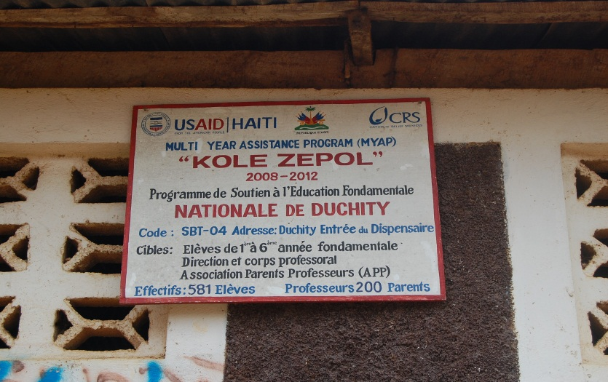
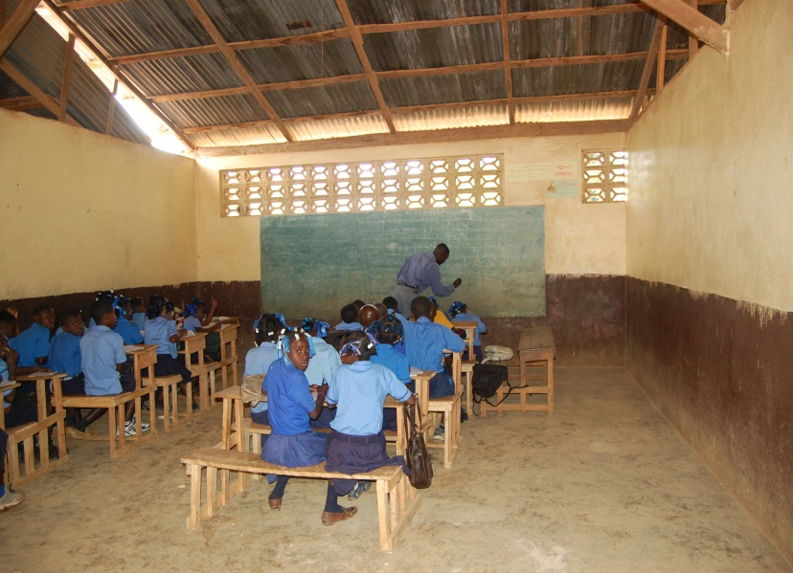
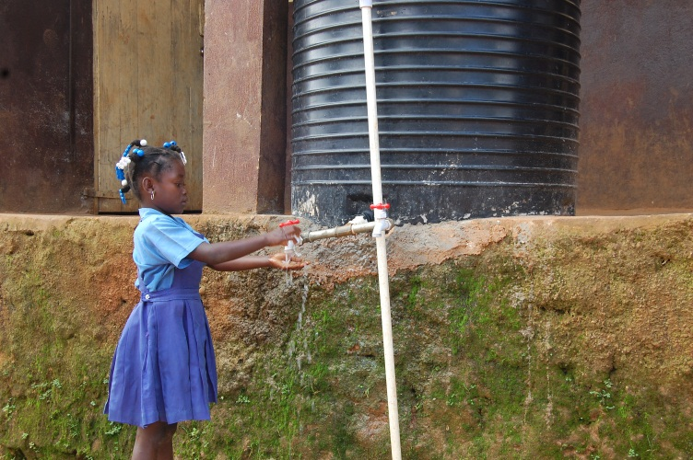
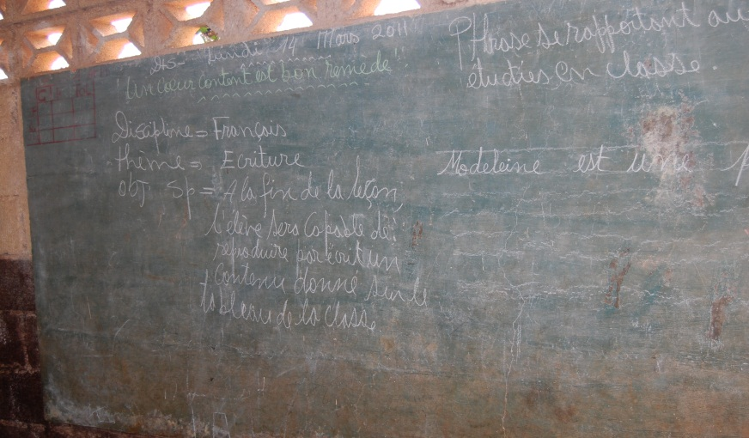
Education in Duchity
Notes:
2011-03-14 c. #261 - #288
2011-03-15 #455

Slide 48
Martha Nussbaum. Frontiers in Justice: Disabilities, Nationalities, Species Membership. Cambridge, Mass: Harvard University Press, 2006.
Nussbaum, Martha C. Creating Capabilities: The Human Development Approach, Belknap Press of Harvard University Press, 2011: 20, 33-34.
Amartya Sen. Development as Freedom. Alfred D. Knopf, INC, 1999.
Robeyns, Ingrid, "The Capability Approach", The Stanford Encyclopedia of Philosophy (Summer 2011 Edition), Edward N. Zalta (ed.), URL = http://plato.stanford.edu/archives/sum2011/entries/capability-approach. Accessed March 12, 2012.
Werhane, P., S.P. Kelley, L.P. Hartmen, D.J. Moberg. Allievating Poverty through Profitable Partnerships: Globalization, Markets and Economic Well-Being, Routledge, 2010: 21, 26-7, 75-85, 91.
Oosterlaken and J. van den Hoven (eds.), The Capability Approach, Technology and Design, Philosophy of Engineering and Technology 5, DOI 10.1007/978-94-007-3879-9_7, © Springer Science+Business Media B.V. 2012

Slide 49
Perrow, C. (1984). Normal Accidents: Living With High-Risk Technologies. Basic Books.
Vermaas, Kroes, Poel, Franssen, Houkes. (2011) A Philosophy of Technology: From Technical Artefacts to Sociotechnical Systems. Morgan & Claypool Publishers.
Pinch, T.J. and Bijker, W. (2009). The Social Construction of Facts and Artifacts. In Technology and Society: Building Our Sociotechnical Future, Johnson, D.G. and Wetmore, J.M., (Eds.). Cambridge, Mass: MIT Press: 107-139.
Hickman, L. (1990). John Dewey’s Pragmatic Technology. Bloomington, IN: Indiana University Press: 140-153.
M. Flanagan, D. Howe, and H. Nissenbaum, “Embodying Values in Technology: Theory and Practice,” in Information Technology and Moral Philosophy, Jeroen van den Hoven and John Weckert, Eds. Cambridge, UK: Cambridge University Press, 2008, pp. 322-353.
Harris, Charles. (2008). “The Good Engineer: Giving Virtue its Due in Engineering Ethics”. Science and Engineering Ethics, 14: 153-164.
Huff, C. and Finholt, T. (1994). Social Issues In Computing: Putting Computing in its Place. New York: McGraw-Hill.
Wanda J. Orlikowski. Using Technology and Constituting Structures: A Practice Lens for Studying Technology in Organizations. ORGANIZATION SCIENCE, 2000 INFORMS. Vol. 11, No. 4, July–August 2000, pp. 404–428

Slide 50
Roopali Phadke. “People’s Science in Action: The Politics of Protest and Knowledge Brokering in India.” In Technology and Society, Johnson and Wetmore eds. MIT Press, 2009, 499-513.
Weber, Rachel N. "Manufacturing Gender in Commercial and Military Cockpit Design." Science, Technology, and Human Values, Vol. 22, No. 2. (Spring, 1997), pp. 235-253. http://www.jstor.org Tue Jan 2 16:14:06 2007
Jamison Wetmore. “Amish Technology: Reinforcing Values and Building Community” in Technology and Society, eds. Johnson and Wetmore. 2009, MIT Press: 298-318
Burkhard Bilger. (2009) “Hearth Surgery: The quest for a stove that can serve the world.” The New Yorker Digital Edition, Dec 21, 2009.
Kenneth L. Kraemer, Jason Dedrick, and Prakul Sharma. "One Laptop Per Child: Vision versus Reality." Communications of the ACM. June 2009, Vol. 52, No. 6: 66-73
C. Baillie, E. Feinblatt, T. Thamae, and E. Berrington. (2010). Needs and Feasibility: A Guide for Engineers in Community Projects--The Case for Waste for Life. Morgan and Claypool.

Slide 51
Jeopardy and Technological Choice
Responsible choice for appropriate technology
http://cnx.org/content/m43922/1.8/
Jeopardy STS IM
Jeopardy Socio Technical Systems (with categories on capabilities and markets)
Technology Choice Cases (OLPC, Amish, Uchangi Dam, Airplane Cockpits)
Tech Choice Cases (Aprovecho, Waste for Life, Human Capabilities)

